Slide 1


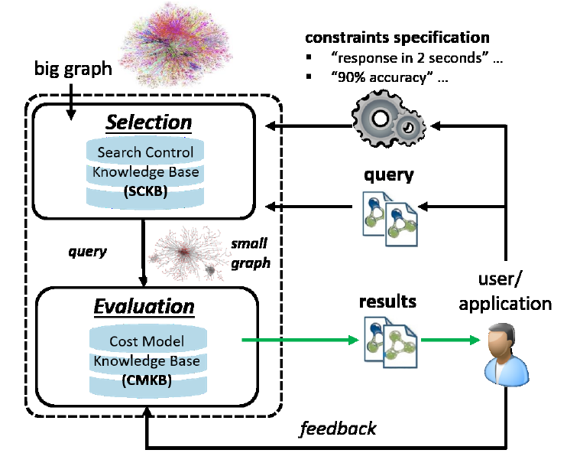






Database Group Case Western Reserve University Yinghui Wu (CWRU/WSU) Students: Sheng Guan, Hanchao Ma
Related Projects
Search Big Data: Query models, optimization and parallelization
Association analysis in Networks
Data Quality & Exploration
Search Big Data
Computationally efficient query models
Data-driven approximate querying - “make Big Data small”
(Semi-auto)Parallelization of sequential computation
Application: Social network, cyber-power system, Web knowledge, Smart Irrigation
Association Analysis in Networks
Association model enhanced by graph patterns
Scalable graph association mining
Association analysis in dynamic networks
Data Quality & Exploration
Fact prediction in knowledge bases
Entity resolution in attributed networks
Data cleaning for graph data
Query provenance and exploratory search
Contact
PI: Olin 515, Dpt. of EECS, CWRU yxw1650@case.edu
Lab: Olin 406 Sheng Guan: sxg967@case.edu Hanchao Ma: hxm382@case.edu

Slide 2
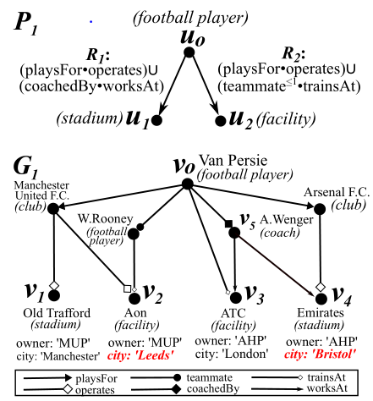
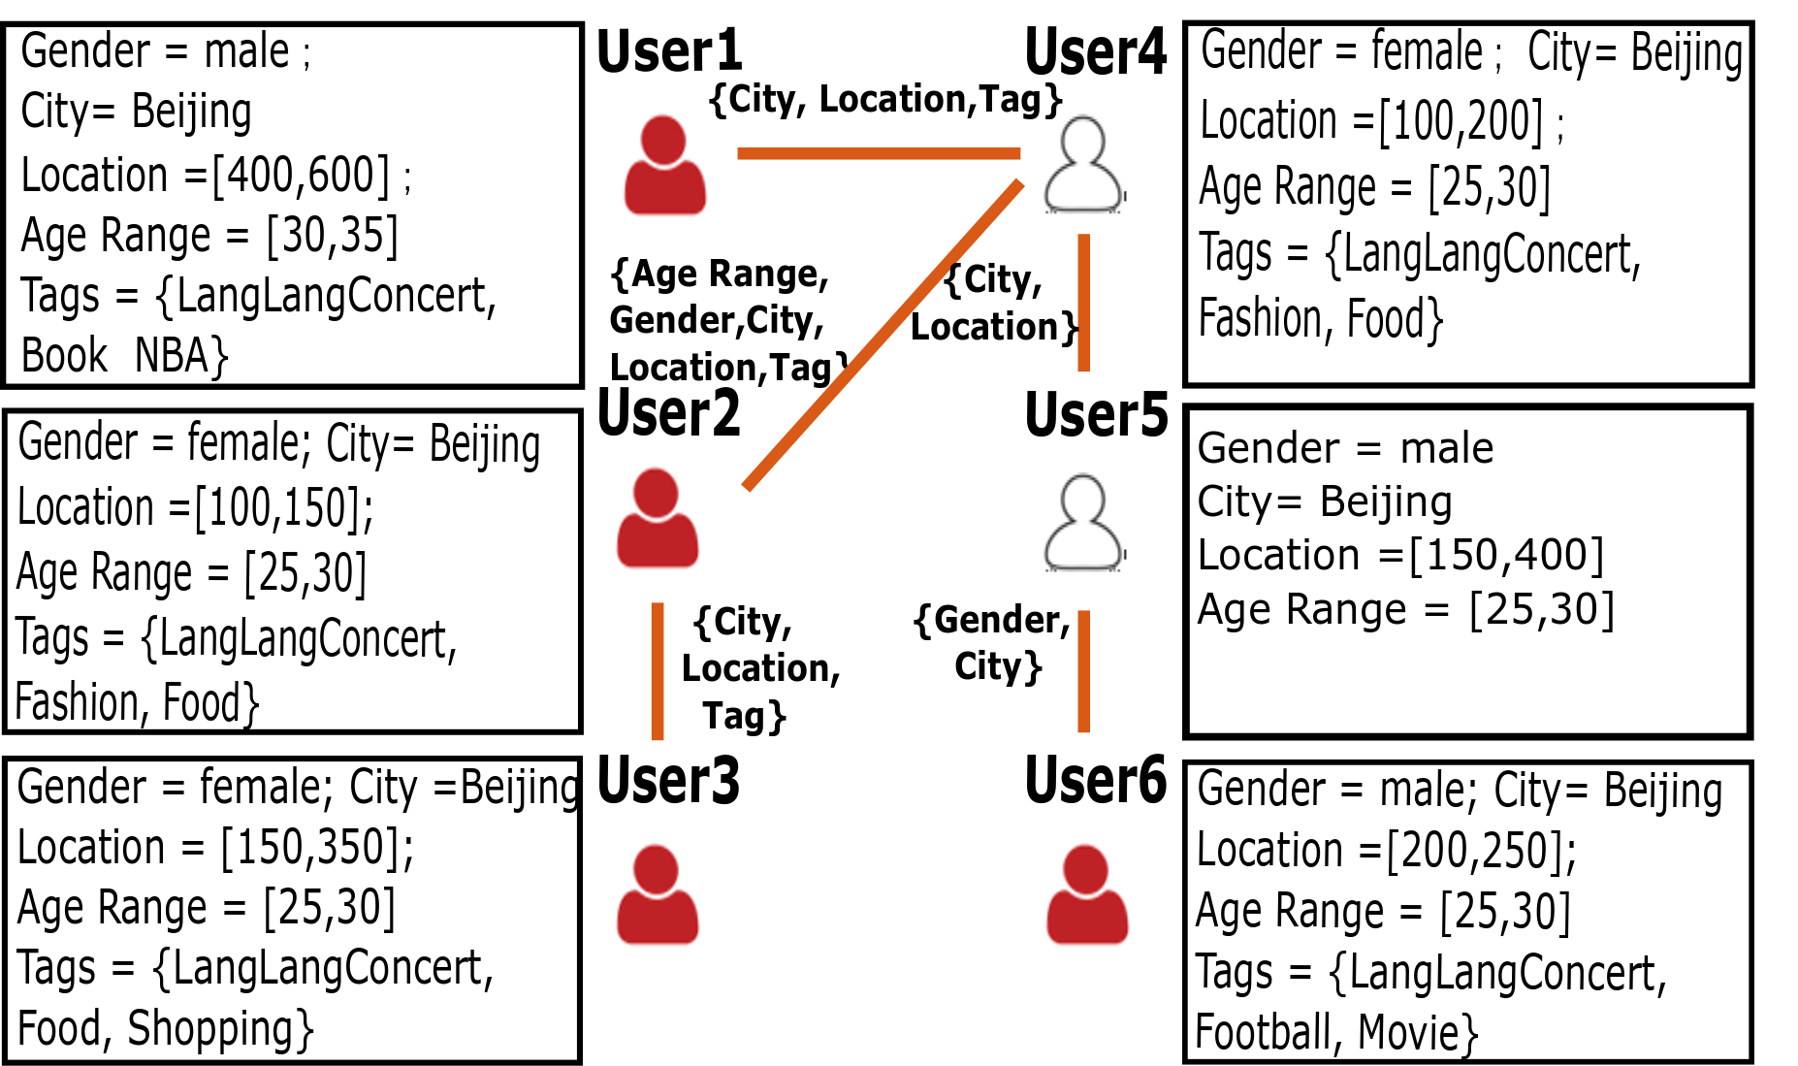
Database Group Case Western Reserve University Yinghui Wu (CWRU/WSU) Students: Sheng Guan, Hanchao Ma
Idea for Phase I Deliverables
Knowledge quality/graph cleaning (Hanchao)
preliminary: (minimum cost) repairs conforming to constraints
idea: A showcase/demo on how data cleaning help credible information and misinformation modeling and inference.
Network models for credible knowledge (Sheng)
preliminary: backbone detection in the context of node/link attributes
idea: detect “small” credible data (use cases/scenarios – connecting to domain models from vertical applications); A showcase locating node/link-driven propagation of credible information
Ongoing: context-driven cyber-power event prediction (Siemens)
Provenance for Credible Knowledge
Ongoing: provenance queries for ML scripts (Mo/Microsoft)

